Slide 1

House Pricing Estimation
מצגת סמינר בלמידה חישובית
מרצה – ד"ר יהודית אפרשטיין
מאת:
דניאל איבקוביץ' - 316421262
ואילון מזרחי - 206125411

Slide 2
Problem Definition
Given a set of features describing a house, estimate It’s price.
Features may include: Total House Area, Garage Area, Fence, Alley, Pool, etc..
For Example:
A house with large total area and a big pool in a good neighbourhood will cost 300,000 USD while a smaller house with worse features will cost 178,000 USD.
The Goal is to use/design a method to optimally and accurately predict the price of a given house.

Slide 3
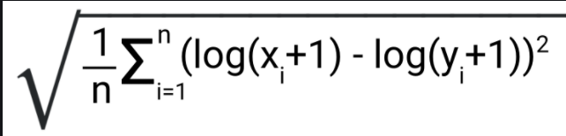
Evaluation Metric for the Competition
The work is evaluated on Root-Mean-Squared-Log-Error (RMSLE) between the logarithm of the predicted value and the logarithm of the observed sales price.
(Taking logs means that errors in predicting expensive houses and cheap houses will affect the result more equally.)

Slide 4
Literature Review
First, we based our work on the paper:
A Hybrid Regression Technique for House Prices Prediction
Sifei Lu, Zengxiang Li, Zheng Qin, Xulei Yang, Rick Siow Mong Goh
at the Institute of High-Performance Computing (IHPC)

Slide 5
Literature Review
Our work was based on couple of resources.
First, we based our work on the paper:
A Hybrid Regression Technique for House Prices Prediction Sifei Lu, Zengxiang Li, Zheng Qin, Xulei Yang, Rick Siow Mong Goh at the Institute of High-Performance Computing (IHPC).
2. Hyper-Parameters optimization: https://www.analyticsvidhya.com/blog/2016/03/complete-guide-parameter-tuning-xgboost-with-codes-python/
3. Deep Learning Regression for house pricing: https://towardsdatascience.com/house-prices-prediction-using-deep-learning-dea265cc3154

Slide 6
Literature Review - Paper
The paper proposes a hybrid Lasso and Gradient boosting regression model to predict individual house price.
General Methods used in this paper:
Feature Engineering
Gradient Boosting
Lasso (Least Absolute Shrinkage and Selection Operator)

Slide 7
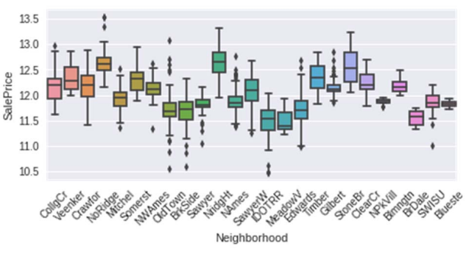
Literature Review
Feature Engineering:
Features Logarithmic transform to the distribution against the target sale price.
Converting categorical/numerical values to numerical/categorical values that are more suitable.
Filling/Replacing missing values.

Slide 8
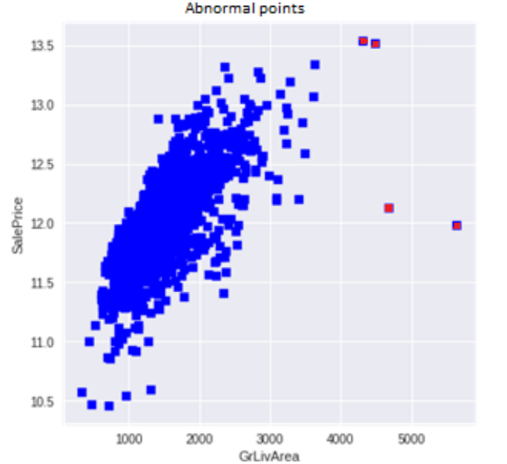
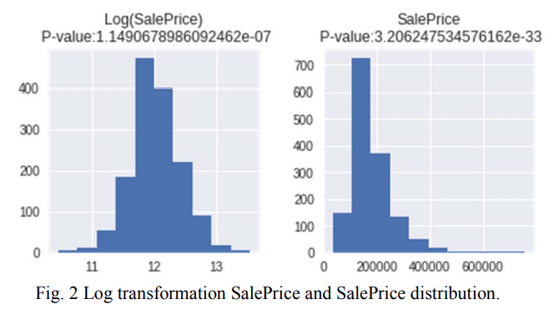
Literature Review
Feature Engineering:
Adding new features, multiplication of Lot Area, GrLiveArea, TotalBsmtSF with OverallQual, ExterQual, and KitchenQual etc. to add new hybrid features.
Log transformation, in order to approximate normal distribution.
Finally, remove abnormal points (outliers) as depicted in the right part of the image below.

Slide 9
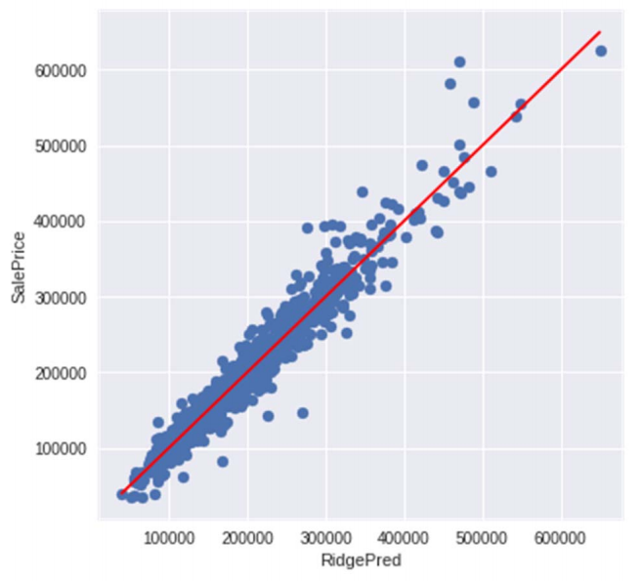
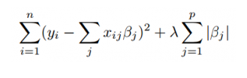
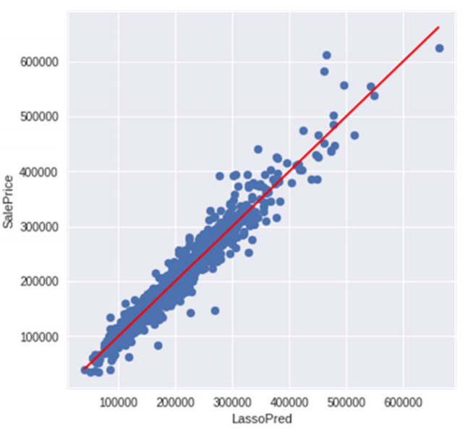
Literature Review
Regression algorithms:
Regularizations:
Ridge regression:
The image shows the Ridge
Lasso regression:
Lasso is useful to perform feature selection.
Prediction in X, and SalePrice in Y for training data.

Slide 10
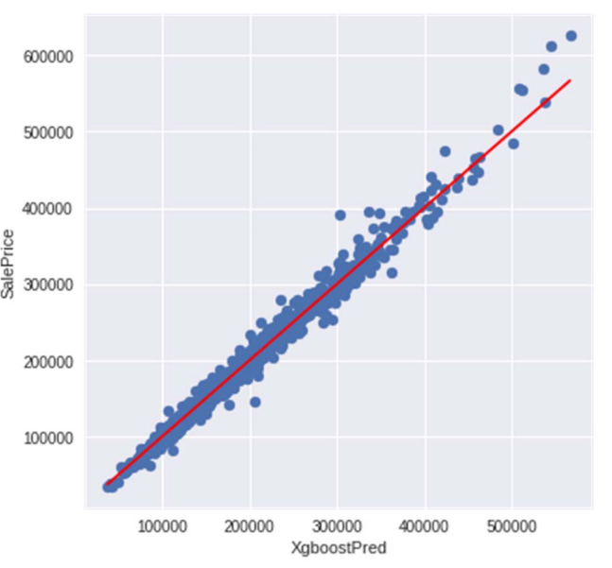
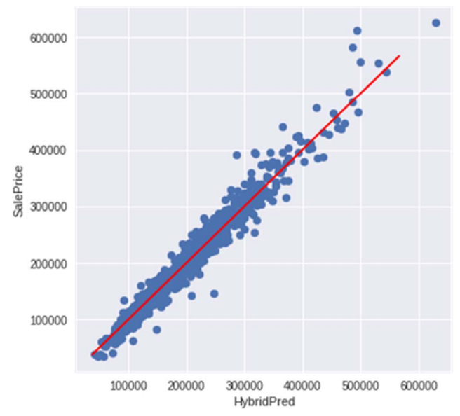
Literature Review
Gradient boosting:
Ensemble of trees, using the Boosting method
Hybrid Regression:
The coupling effect of multiple regression algorithms.
The hybrid regressions result is better than one specific
regression algorithm, according to the paper.
Prediction in X, and SalePrice in Y for training data.

Slide 11
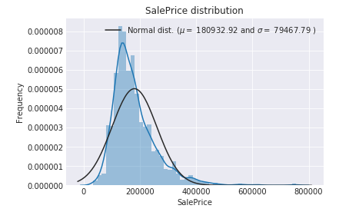
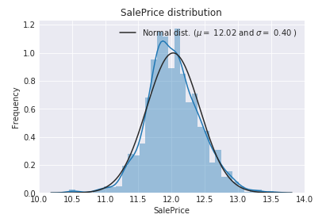
Our Methodologies
Feature Engineering:
Transforming skewed values (including the target):
The target variable is right skewed.
As (linear) models nicely match normally distributed data , we need to transform this variable and make it more normally distributed.

Slide 12
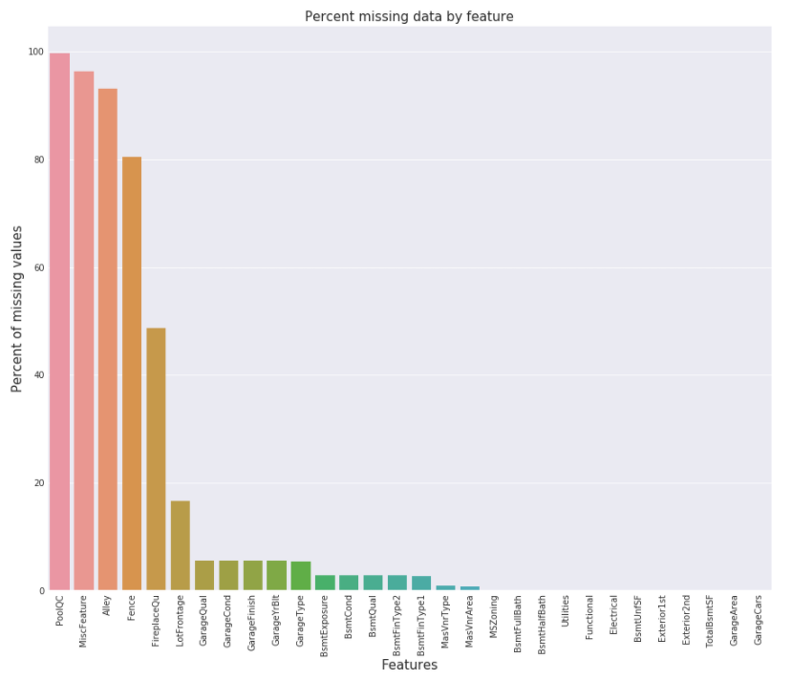
Our Methodologies
Feature Engineering:
Dealing with missing Data:
There are features that almost no house
Has, for example, a pool.
The image to the right shows the top features
That are missing in most of the examples.
In some cases we fill the void with None
Values and in other cases with numerical
values such as zero in order
to suggest that it doesn’t exist.

Slide 13
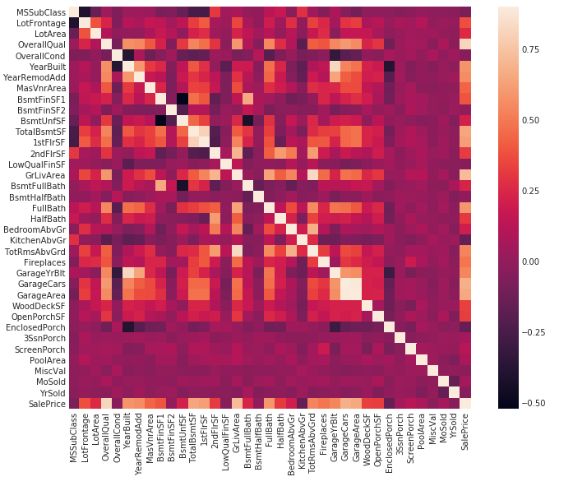
Our Methodologies
Data Correlation to the target value- Sale Price:
Before we add new features, we are interested in knowing correlations between the different features, so we know which ones to combine.
The Following image presents a heat map
that shows correlation between the features.
Notice the high correlation between
garageArea, garageCars:
*Notice every feature highly correlates with itself..

Slide 14
Our Methodologies
Feature Engineering:
Adding Custom Features:
Since area related features are very important to determine house prices, we add more features which are the total area of basement, first and second floor areas of each house.
In addition, numerous types of combinations were added according to the heat map demonstrated before. The idea is to generate new features that correlate together and contribute to the sale price in a predictable manner.

Slide 15
Our Methodologies
Execution:
We used several regression models and evaluated their results:
LASSO Regression
Elastic Net Regression
Kernel Ridge Regression
Gradient Boosting Regression
XGB (Extreme Gradient Boosting)
Light GBM (Light Gradient Boosting Machine)
Deep Neural Network

Slide 16
Our Methodologies
LASSO Regression
The “LASSO” stands for Least Absolute Shrinkage and Selection Operator. Lasso regression is a regularization technique. It is used over regression methods for a more accurate prediction.
Lasso Regression uses L1 regularization technique. It is used when we have a greater number of features because it automatically performs feature selection.
Residual Sum of Squares + λ * (Sum of the absolute value of the magnitude of coefficients)
λ denotes the amount of shrinkage.
λ = 0 implies all features are considered and it is equivalent to the linear regression where only the residual sum of squares is considered to build a predictive model
λ = ∞ implies no feature is considered i.e, as λ closes to infinity it eliminates more and more features
The bias increases with increase in λ
variance increases with decrease in λ

Slide 17
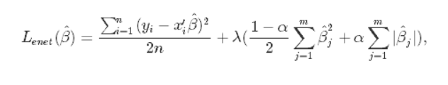
Our Methodologies
Elastic Net Regression
Elastic Net first emerged as a result of critique on lasso, whose variable selection can be too dependent on data and thus unstable. The solution is to combine the penalties of ridge regression and lasso to get the best of both worlds. Elastic Net aims at minimizing the following loss function:
where α is the mixing parameter between ridge (α = 0) and lasso (α = 1).

Slide 18

Our Methodologies
Kernel Ridge Regression
Kernel ridge regression (KRR) combines ridge regression with the kernel trick*. It thus learns a linear function in the space induced by the respective kernel and the data. For non-linear kernels, this corresponds to a non-linear function in the original space.
In our project, we used the polynomial kernel from order 2.
A kernel is a functions that maps the feature space to another space that can distinguish between different data samples without computing the actual coordinates of the data in a higher dimensional space.
the polynomial kernel looks not only at the given features of input samples to determine their similarity, but also combinations of these.
x and y are vectors in the input space:

Slide 19
Our Methodologies
Gradient Boosting Regression
Gradient Boosting trains many models in a gradual, additive and sequential manner.
Gradient boosting is a machine learning technique for regression and classification problems, which produces a prediction model in the form of an ensemble of weak prediction models.
It builds the model in a stage-wise fashion as other boosting methods do, and it generalizes them by allowing optimization of an arbitrary differentiable loss function.
Gradient boosting is typically used with decision trees of a fixed size as base learners.

Slide 20
Our Methodologies
X Gradient Boosting
XGBoost is one of the most loved machine learning algorithms at Kaggle. Teams with this algorithm keep winning the competitions. It can be used for supervised learning tasks such as Regression, Classification, and Ranking.
XGBoost is one of the implementations of the Gradient Boosting concept, but what makes it unique is that it uses a more regularized model formalization to control over-fitting, which gives it better performance. The most important differences between XGB and GB are:
1.) While regular gradient boosting uses the loss function of their base model (e.g. decision tree) for minimizing the of the overall error, XGBoost uses the 2nd order derivative as an approximation (second-order gradients).
2.) XGB also uses a regularization method (L1 & L2), which improves model generalization.

Slide 21
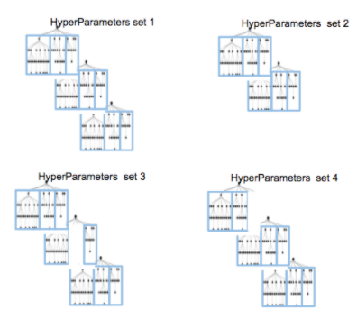
Our Methodologies
X Gradient Boosting
The most important differences between XGB and GB are:
1.) While regular gradient boosting uses the loss function of their base model (e.g. decision tree) for minimizing the of the overall error, XGBoost uses the 2nd order derivative as an approximation (second-order gradients).
2.) XGB also uses a regularization method (L1 & L2),
which improves model generalization.
3.) Performance and Parallelism:
Each branch of the tree is trained separately.

Slide 22
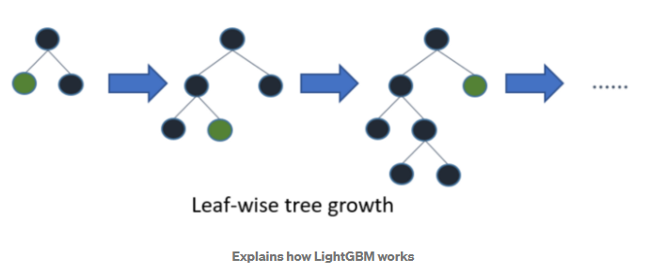
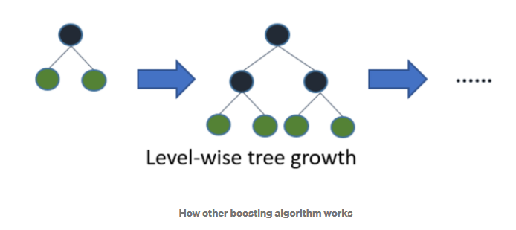
Our Methodologies
Light GBM (Light Gradient
Boosting Machine)
LightGBM is one kind of GB algorithms.
Has many of XGBoost's advantages (parallel training, multiple loss functions, regularization, etc.)
The major difference is that Light GBM grows trees vertically while other algorithms grow trees horizontally meaning that Light GBM grows tree leaf-wise while other algorithms grow level-wise. It will choose the leaf with max delta loss to grow. When growing the same leaf, Leaf-wise algorithms can reduce more loss than a level-wise algorithm.
Faster training speed, higher efficiency and lower memory usage: Light GBM use histogram-based algorithm i.e it buckets continuous feature values into discrete bins which fasten the training procedure and lower the memory usage, Thus it is compatible with large datasets.
High accuracy: Growing trees Leaf-Wise could lead to a better accuracy score, But, could also lead to an overfitting.

Slide 23
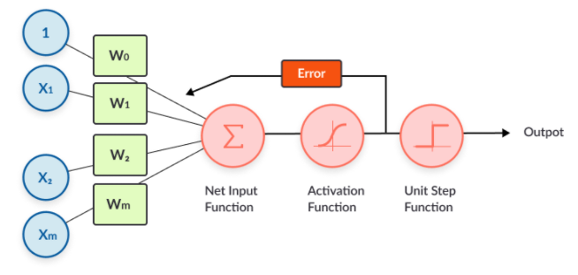
Our Methodologies
Deep Neural Network
Neural networks are reducible to regression models—a neural network can “pretend” to be any type of regression model.
A neural network is a flexible model that adapts itself to the shape of the data.
It can dynamically pick the best type of regression (linear, logistic, polynomial. Etc.)
and if it’s not accurate enough, you can add hidden neuron layers to make the model more complex and improve its prediction power.

Slide 24
Our Methodologies
Deep Neural Network
Challenges among the current competition:
NN overfits to the training data faster than other algorithms (Linear Regression…)
NN works better on larger datasets.

Slide 25
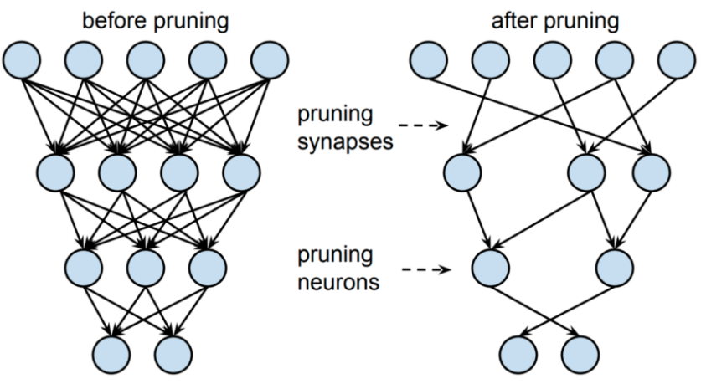
Our Methodologies
Deep Neural Network
Solutions:
Weighted Optimizing Algorithm (regularization).
Network Purning:
Weights (connections) removal.
Nodes removal.
After pruning, you may observe that the model
performance has suffered. This can be fixed by
fine-tuning, meaning retraining the model after
pruning to restore accuracy.
We used random pruning.

Slide 26
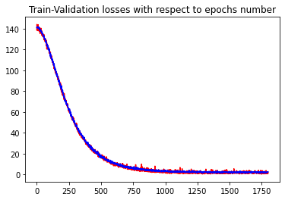
Our Methodologies
Deep Neural Network
The Graph below presents the Train/Validation losses with respect to the number of epochs
After training the Deep Regressor model with 1800 iterations
and a learning rate of 0.0001 using Weighted Adam optimizer
and the Cosine Annealing scheduler.
Train losses in red.
Validation losses in blue.
Notice that there is a good balance between train/val.

Slide 27
Our Methodologies
“Ensembling”
Despite the different “ensembling” algorithms described before, we tried to create our own ensemble of models.
First, we used average among the model predictions.
Also, we tried a more complex method: Stacking models with a meta-model.
Each model is trained on a different part from the training set (K-Folds). We used the 5-fold cross validation method.
A single meta-model is trained on the other model predictions (on the corresponding validation sets) and is aimed to learn the optimal weights to set to each of the other models. We chose KRR as the meta model.
Together, all of the models are aimed to predict the optimal target (sale price).

Slide 28
Our Methodologies
But…
The paper methodologies may be a bit obsolete (2016) and the competition was fierce.
Apparently, after using some of the methods depicted before, the Kaggle’s score wasn’t high enough.
Hence, we used the Deep Learning Regression, but we were still disappointed about the score.

Slide 29
Our Methodologies
After investigating the score for several times (with and without some functions), fine-tuning the hyper-parameters and more, we assumed that the reasons to these results are:
Outliers removal is not always safe, as the reality is not utopic.
In this scenario, the log transformation hurt the data representation, also, the reality is not a pure linear function and the data distribution is not a pure normal distribution.

Slide 30
Our Methodologies
We assumed that the reasons to these results are:
3. Adding some of the features hurt the data, because the dataset is not large enough to deal with them successfully.
4. Filling some “logic values” instead of the missing values could sometimes hurt the data quality as well.
5. Sometimes, some of the ensembled models reduce the performance of the whole ensemble. Then, it is necessary to chose the models to be considered wisely.

Slide 31
Our Methodologies
To fix the issues described before:
We examined different hyper-parameters.
Removed some of the methods used before and evaluating them against both Validation RMSLE score and Kaggle’s test score.
Read a lot of other Kaggle’s notebooks.
…

Slide 32
Training
Pre-Training Data Preparation
Before we start training, there we made more adjustments to the data using existing modules:
For ordinal data we used an Ordinal Encoder (as it much more appropriated for Tree-Based models)
Standard Scaler for numerical data.

Slide 33
Training
Pre-Training Data Preparation
Nominal and ordinal are two of the four levels of measurement.
Nominal level data can only be classified, while ordinal level data can be classified and ordered.
Numerical data is understood from its name (e.g., numerical value for the feature).
Ordinal Encoding
In ordinal encoding, each unique category value is assigned an integer value.
For example, “red” is 1, “green” is 2, and “blue” is 3.
This is called an ordinal encoding or an integer encoding and is easily reversible. Often, integer values starting at zero are used.

Slide 34
Training
Pre-Training Data Preparation
Hyper-Parameter Tuning
Hyperparameters cannot be directly learned from the regular training process. They are usually fixed before the actual training process begins. These parameters express important properties of the model such as its complexity or how fast it should learn.
Models can have many hyperparameters and finding the best combination of parameters can be treated as a search problem.

Slide 35
Training
Pre-Training Data Preparation
Hyper-Parameter Tuning - GridSearchCV
In GridSearchCV approach, machine learning model is evaluated for a range of hyperparameter values. It searches for best set of hyperparameters from a grid of hyperparameters values. For example, if we want to set two hyperparameters C and Alpha of Logistic Regression Classifier model, with different set of values. The gridsearch technique will construct many versions of the model with all possible combinations of hyperparameters and will return the best one.

Slide 36
Training
Pre-Training Data Preparation
Hyper-Parameter Tuning - RandomizedSearchCV
RandomizedSearchCV solves the drawbacks of GridSearchCV, as it goes through only a fixed number of hyperparameter settings. It moves within the grid in random fashion to find the best set hyperparameters. This approach reduces unnecessary computation.
We chose to tune the learning rate and select the best one in the interval 0.01-0.11 using the first method(GridSearchCV) because that data was small, and the computation time was quick.

Slide 37
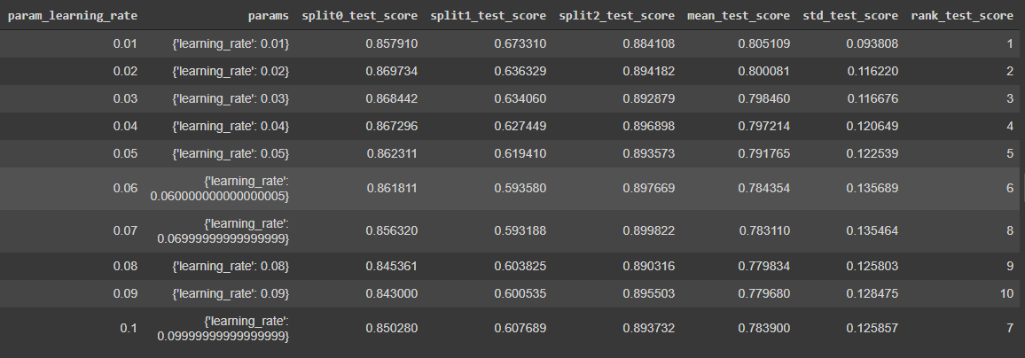
Training
Pre-Training Data Preparation
Hyper-Parameter Tuning

Slide 38
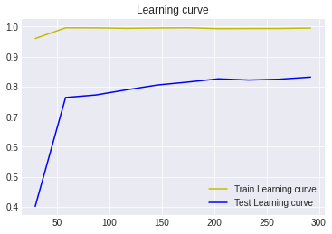
Training
XGB Regression
The Graph below presents the Learning curve for variable subsets of the Train and validation sets, after training the XGB model with 1000 estimators and a learning rate of 0.01.

Slide 39
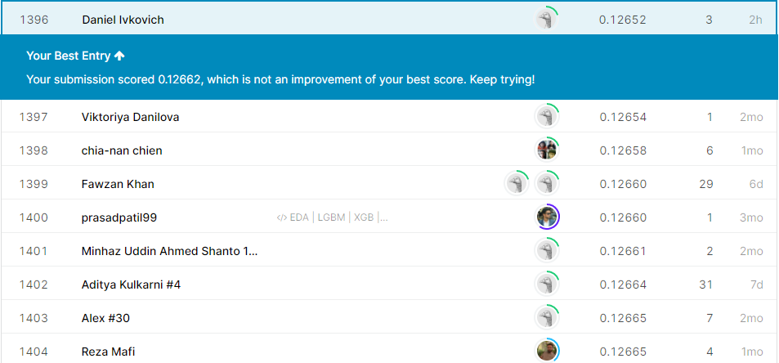
Our Results
Rank 1396 out of 5970 participants.
Model Name | RMSE Score (val)
Lasso | 0.1115
ElasticNet | 0.1116
Gradient Boosting | 0.1167
Xgboost | 0.1150 → 0.12652 in Kaggle.
Light GB Machine | 0.1176
Deep Neural Network | 2.5 (MSE)
Average Stacked Models | 0.07294
& Eylon Mizrahi

Slide 40
Our Results
Conclusion:
We can see that each of the models by itself produces quite a similar results, but ensembled together and after averaging the estimation of the entire stack, we can see a great improvement in the precision on the validation (or on the part of the test set that exposed to us) predictions.
With XGB algorithm we gained the highest Kaggle score.
Ways to Improve from here:
Improvements in Data Preparations can possibly be made to increase the score.
The work is based on a paper from 2016 and might be over dated – better models or methods might exist by now.

Slide 41
The End ?

